Slide 1






JavaScript (conditional statements)
www.wscubetech.com

Slide 2
Our Agenda.
What are conditional statements ?
Examples of each type.
Types of conditional statements in Js.
www.wscubetech.com

Slide 3
What are conditional statements?
Operator.
Conditional statements (control statements) are used to change the flow of the program’s execution.
Two possible cases, either true or false.
www.wscubetech.com

Slide 4
Types of conditional statements in JavaScript.
if
If –else-if
If- else
www.wscubetech.com

Slide 5
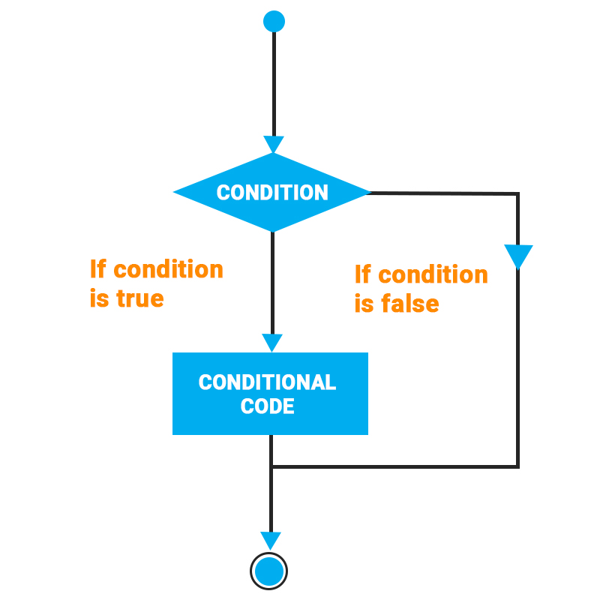
if statement in JavaScript.
Syntax:
if (condition) { // block of code to be executed
//if the condition is true }
www.wscubetech.com

Slide 6
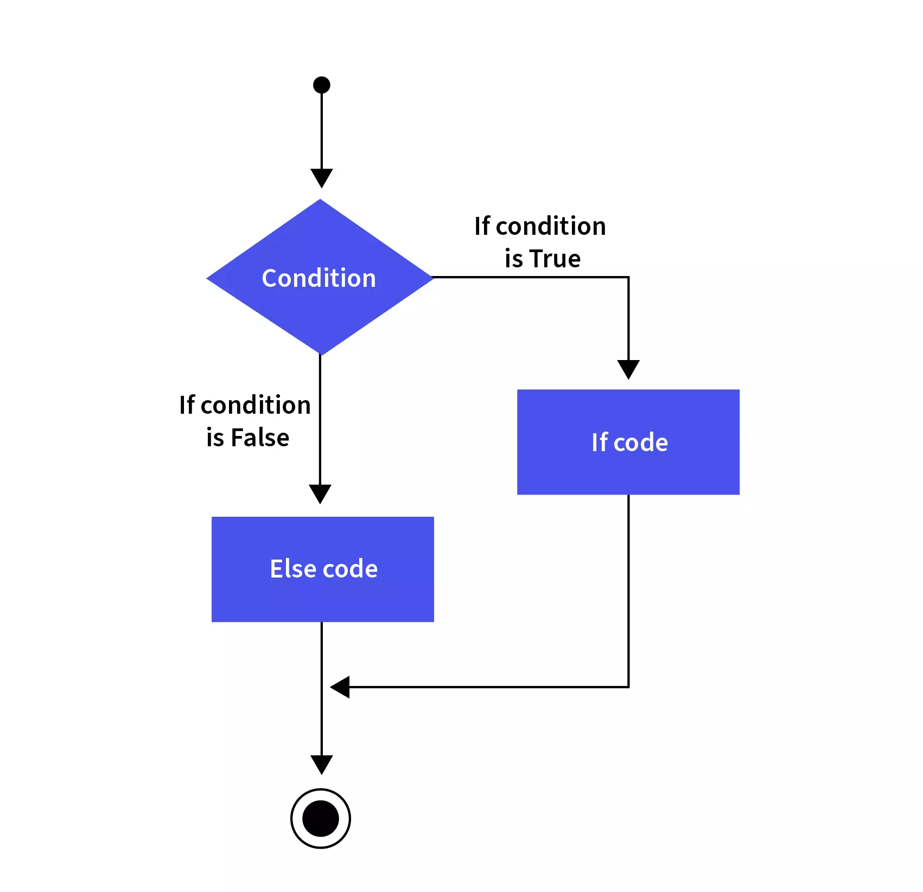
if-else statement in JavaScript.
Syntax:
if (condition) { // block of code to be executed
//if the condition is true }else{
//if the condition is fasle
}
www.wscubetech.com

Slide 7
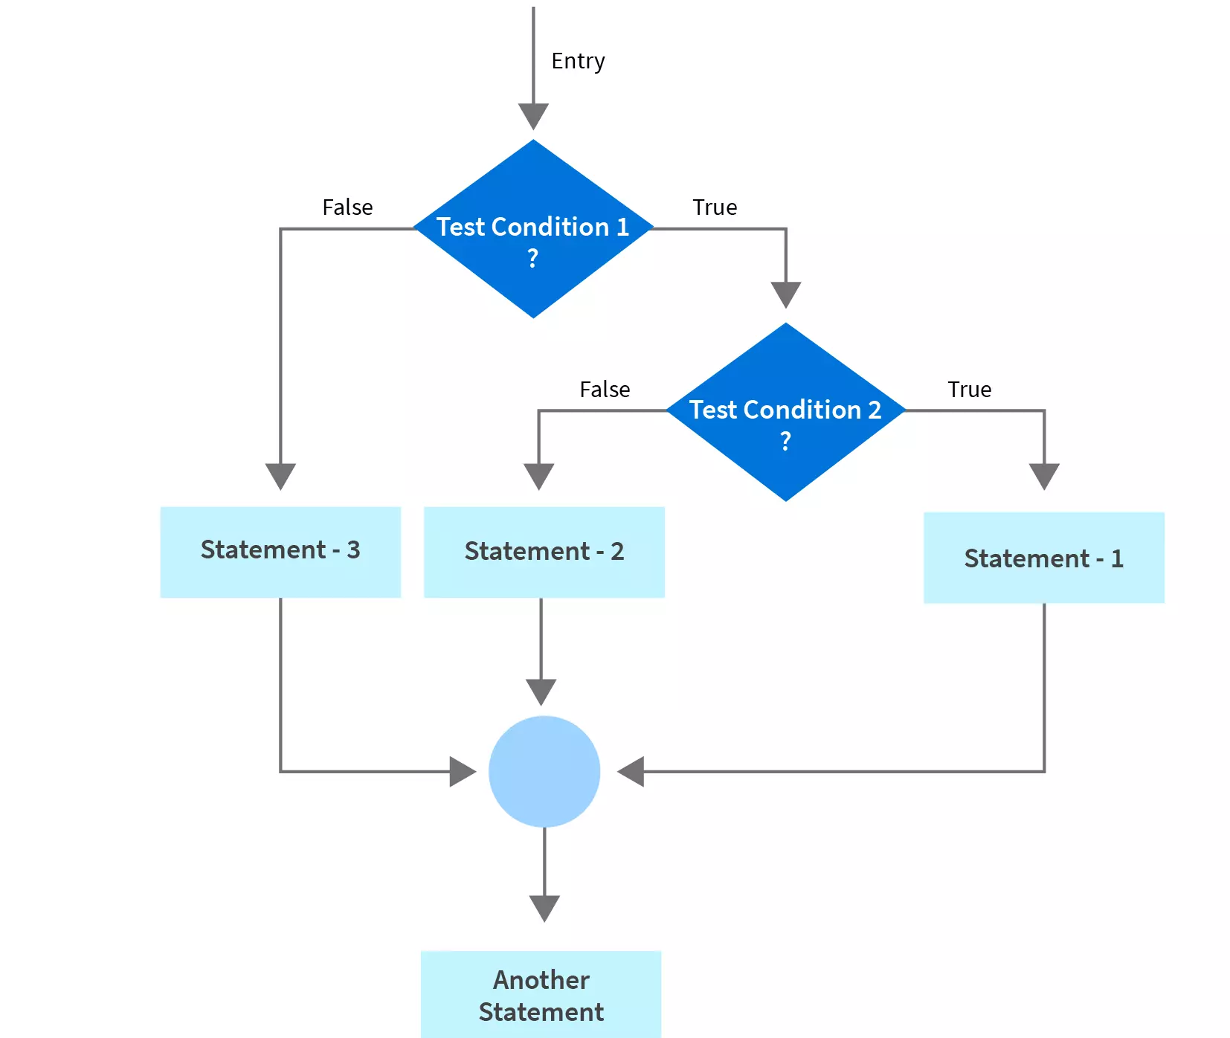
if-else-if statement in JavaScript.
Syntax:
if (cond1) { // block of code to be executed
//if the condition is true }else if(cond2){
//if the condition is false
}else{
}
www.wscubetech.com

Slide 8



@wscube
@wscubetech.india
www.wscubetech.com
Subscribe To Get Notified about New Videos

